Slide 1
Cyflwyniad Fforwm Ysgolion Pob-Oed
All Age Schools Forum presentation
Ysgol Garth Olwg
02.07.2024

Slide 2
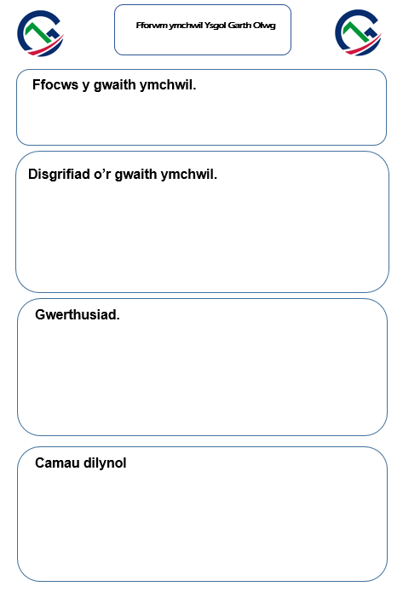
Ymchwil gweithredol – Mai/Mehefin 2020
Action Research – May/June 2020

Slide 3
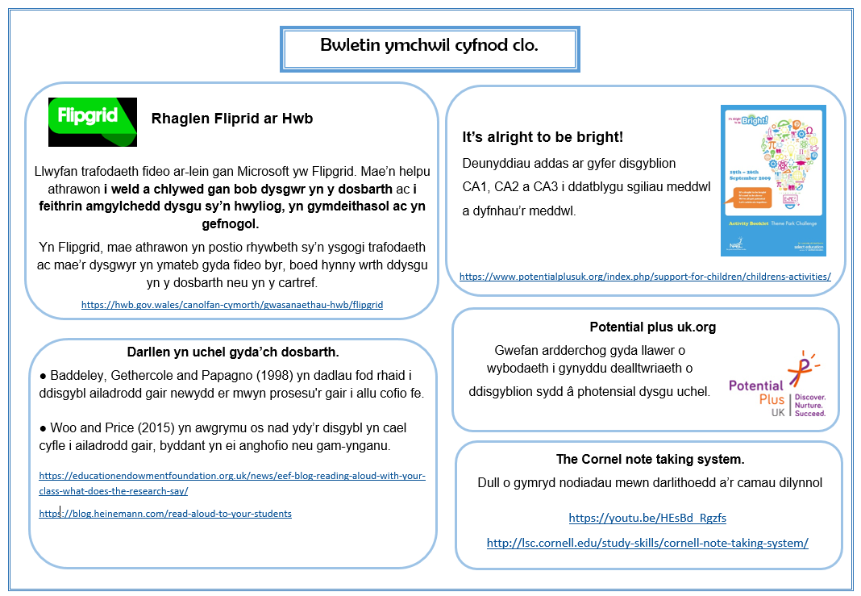

Slide 4
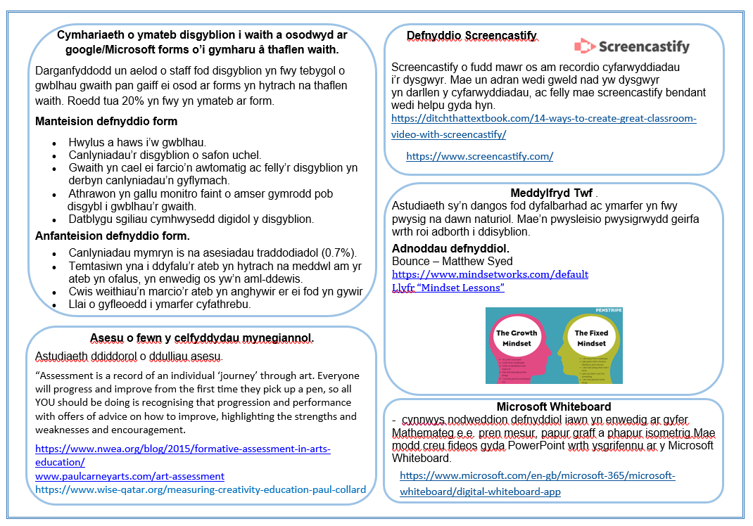

Slide 5
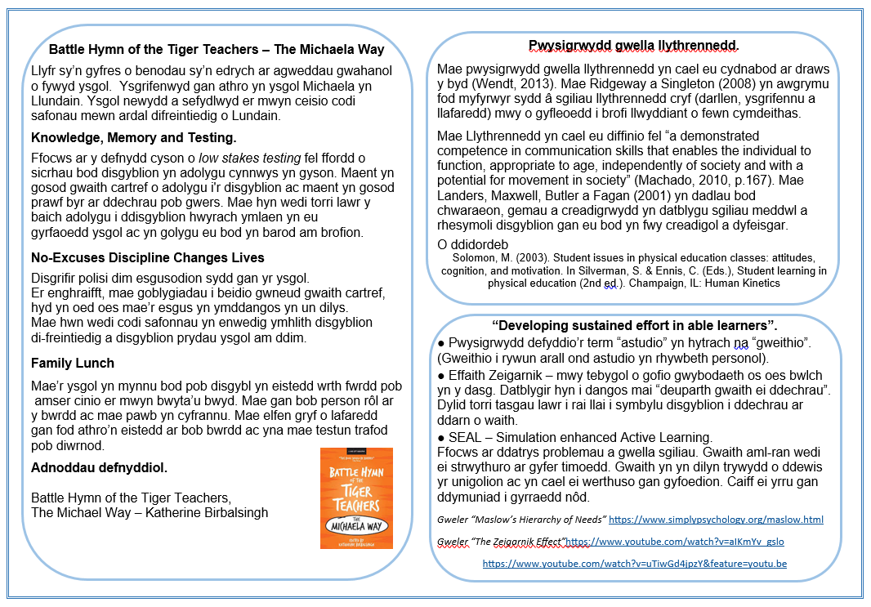

Slide 6
Adroddiad effaith bwletinau ymchwil a chyflwyniadau ymchwil mewn DP
Impact report on the Research bwletins and presentations during PD.
DP. 03.09.2020
Flipgrid
Screencastify
Dysgu Fflip/Flipped Learning
Battle Hymn of the Tiger Teachers, The Michaela Way
Meddylfryd Twf/Growth Mindset
Google sites

Slide 7
*
* *

Slide 8
Camau nesaf
Creu diwylliant o fewn yr ysgol lle mae gwaith ymchwil yn rhan annatod o’n gwaith dydd i ddydd.
Sicrhau fod unrhyw aelod o staff sy’n gwneud ymchwil yn cael y cyfle i rannu hyn gyda gweddill y staff naill ai mewn cyfarfod staff/DP neu trwy fwletin.
Trefnu triawdau staff i ymgymryd a phynciau penodol. Bydd yr ymchwil yma yn cynnwys treialu dulliau gyda disgyblion neu grwpiau ac adrodd nol ar ganfyddiadau.
Gwaith ymchwil y myfywyr TAR – rhoi cyfleoedd i’r myfyrywyr rannu eu ymchwil gyda’u adrannau ac mewn bwletin ymchwil.
Next steps
Create a culture where research is an integral part of our daily routine
Ensure that any mamber of staff undertaking research has the opportunity to share with the rest of the staff either during a staff meeting/PD or bwletin
Organise staff triads to undertake specific subjects. This research will include trialling methods with pupils or staff and reporting findings.
The Research findings of our PGCE students – giving the students opportunities to share their research with their departments and in a research bulletin

Slide 9
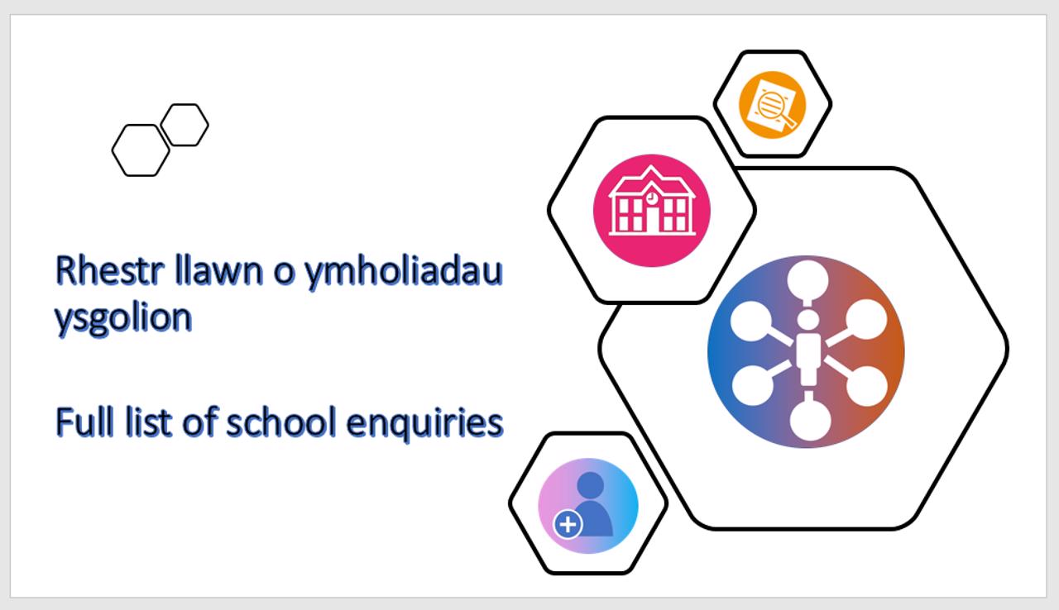
Camau diynnol/Subsequent steps
Ymchwil triawdau a Ffair Ymchwil (2021/22 a 2022/23)
Triad research and Research Fair (2021/22 and 2022/23)
https://hwb.gov.wales/datblygiad-proffesiynol/prosiect-ymholi-proffesiynol-cenedlaethol/

Slide 10
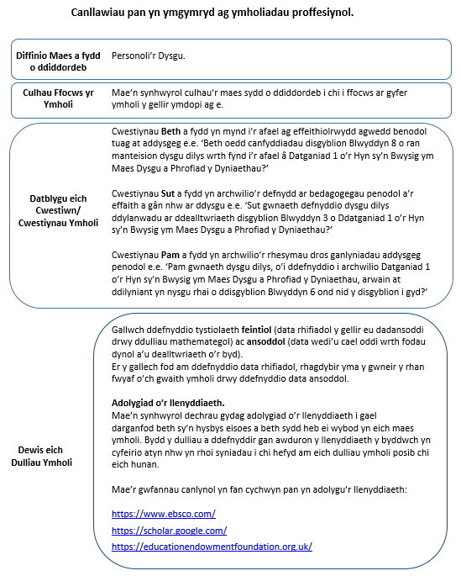
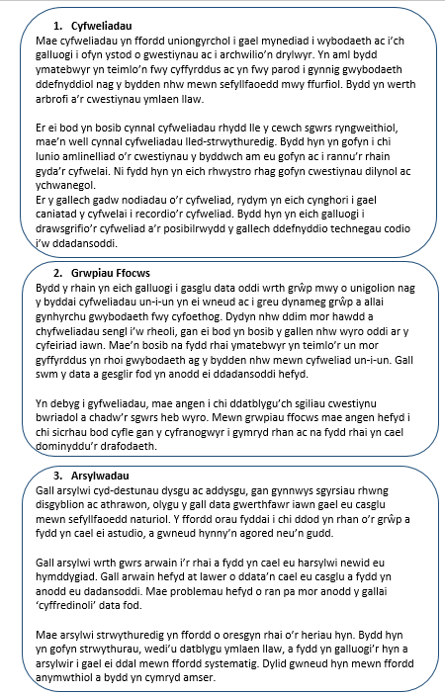

Slide 11
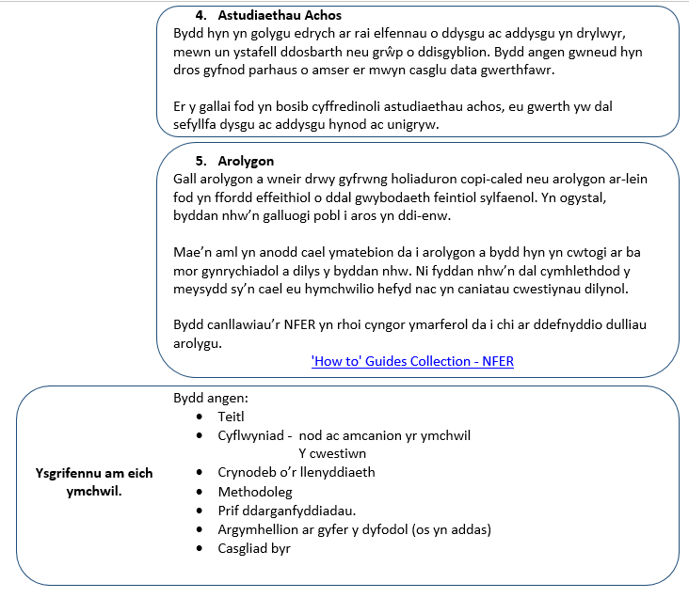

Slide 12
Diffinio Maes a diddordeb | Agwedd o’r Cynllun Datblygu
Culhau Ffocws yr Ymholi | Mae’n synhwyrol culhau’r maes sydd o ddiddordeb i chi i ffocws ar gyfer ymholi y gellir ymdopi ag e.
Datblygu eich Cwestiwn/ Cwestiynau Ymholi | Cwestiynau Beth Cwestiynau Sut Cwestiynau Pam
Adolygiad o’r llenyddiaeth | Gallwch ddefnyddio tystiolaeth feintiol ac ansoddol https://www.ebsco.com/ https://scholar.google.com/ https://educationendowmentfoundation.org.uk/
Define field and interest | Aspect of Development plan
Narrowing the focus of inquiry | It is sensible to narrow your area of interest to a manageable focus for inquiry
Develop your question/ inquiry questions | What questions How questions Why questions
Literature review | You can use both qualitative and quantitative evidence https://www.ebsco.com/ https://scholar.google.com/ https://educationendowmentfoundation.org.uk/

Slide 13
Dulliau ymchwil | Cyfweliadau Grwpiau Ffocws Arsylwadau Astudiaethau Achos Arolygon
Ysgrifennu am eich ymchwil | Bydd angen: Teitl Cyflwyniad - nod ac amcanion yr ymchwil Y cwestiwn Crynodeb o’r llenyddiaeth Methodoleg Prif ddarganfyddiadau Argymhellion ar gyfer y dyfodol (os yn addas) Casgliad byr
Research methods | Interviews Focus groups Observations Case studies Inspections
Ysgrifennu am eich ymchwil | Needed: Title Introduction - Aims and objectives The Question Literature review Methodology Main findings Recommendations for the future (if suitable) Short conclusion

Slide 14
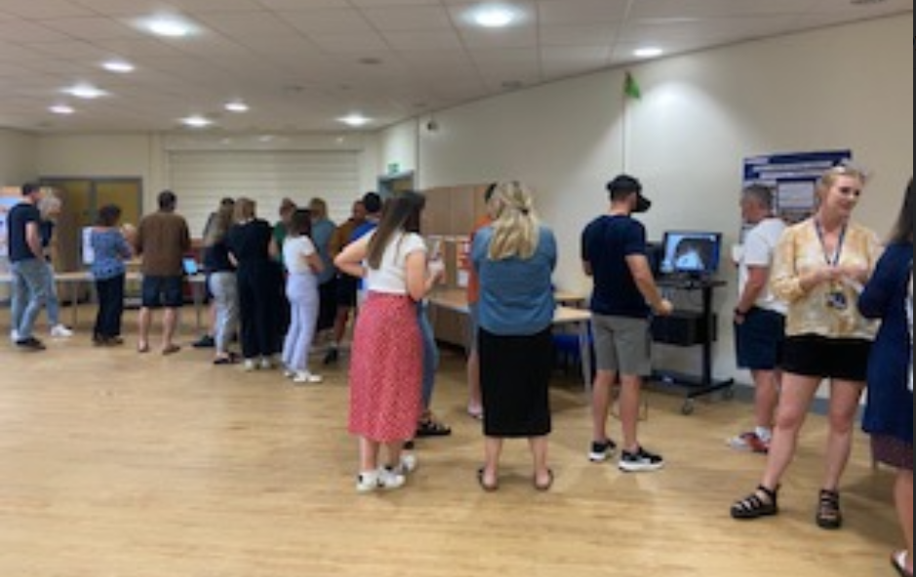

Slide 15
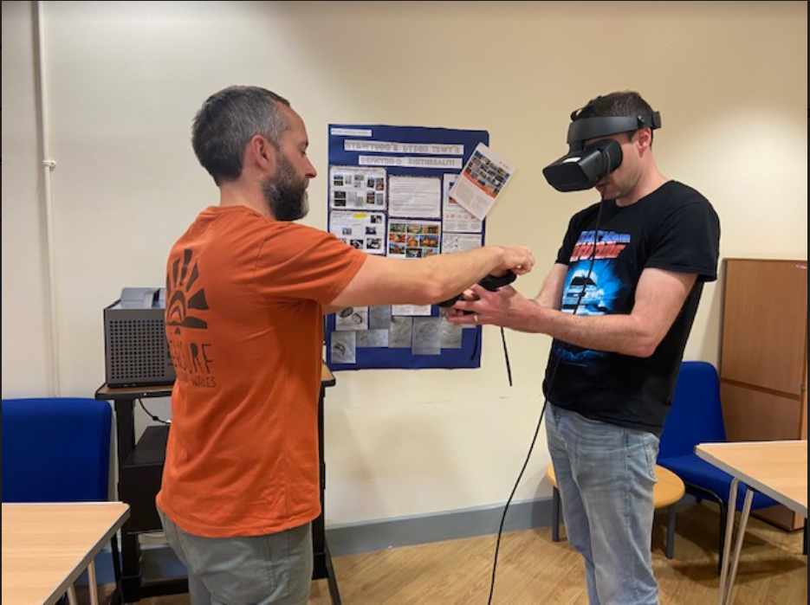

Slide 16
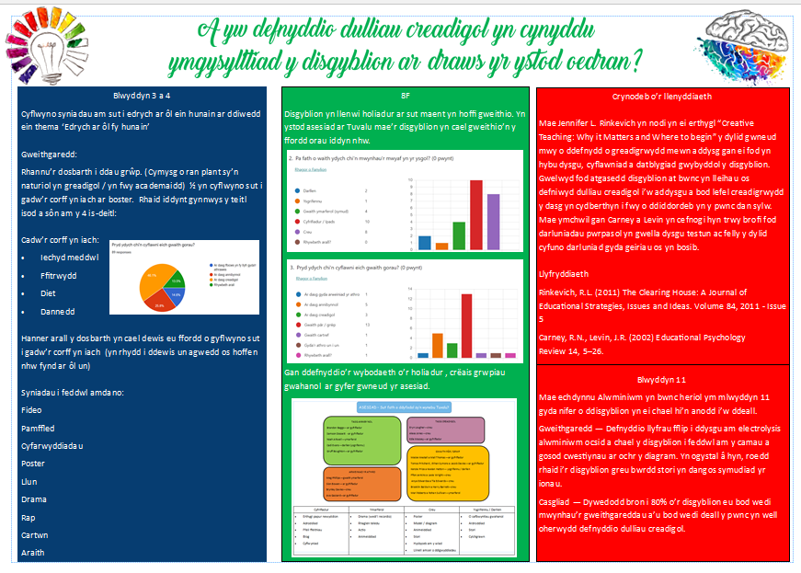

Slide 17

Sbot-Iau

Slide 18
2023/24
Tymor 1
O fewn adrannau:
Walkthrus (Ymddygiad a pherthnasoedd)
– Arsylwi gwersi a thrafod mewn cyfarfodydd adran
Tymor 2 a 3
Triawdau – Trefnu yn dilyn cyfres arfarniadau mis Tachwedd
Edrych ar dargedau’r staff
Dewis thema o Walkthrus
Adrodd yn ôl yn Sbot-Iau, DP
Term 1
Within departments:
Walkthrus (Behaviour and Relationships)
- Observe lessons and discuss in department meetings
Term 2 and 3
Triads – Organise following November lesson appraisals
Consider staff targets
Choose theme from Walkthrus
Report Back during Sbot-Iau, PD

Slide 19
Gwahaniaethu Differentiation | Ymddygiad/Behaviour – Silence is golden | Cwestiynu Questioning
Darllen Reading | Fframio cadarnhaol Positive framing | Adborth Feedback
Gwahaniaethu Anelwch yn uwch (Llyfr 1 – 58) https://drive.google.com/file/d/1XsYDMlKG_HHOB-Gc05nHMSNuzx_2Vtgh/view Ysgol anhawster (Llyfr 2 -128) https://drive.google.com/file/d/18v4MtEkuz0MJMF2NVFYf1MVP0ZdlR3qD/view Addysgu’r goreuon (Llyfr 2 – 68) https://drive.google.com/file/d/1F_sVW_dP7IUekgm4xTKdXsn4ItdmafuJ/view ADY: Anelu’n uchel, cynllunio cymorth (Llyfr 2 – 70) https://drive.google.com/file/d/1F_sVW_dP7IUekgm4xTKdXsn4ItdmafuJ/view | Adborth Adborth sy’n symud ymlaen (Llyfr 1 – 104) https://drive.google.com/file/d/1nV0SkqPZC9Hj2uyalaQnTgL8U30pPCza/view Adborth fel camau gweithredu (Llyfr 1 – 106) https://drive.google.com/file/d/1nV0SkqPZC9Hj2uyalaQnTgL8U30pPCza/view Adborth Dosbarth Cyfan (Llyfr 1 – 108) https://drive.google.com/file/d/1nV0SkqPZC9Hj2uyalaQnTgL8U30pPCza/view | Darllen Cynlluniwch ar gyfer darllen (Llyfr 1 – 60) https://drive.google.com/file/d/1XsYDMlKG_HHOB-Gc05nHMSNuzx_2Vtgh/view Building a culture of reading (Llyfr 3 – 70)

Slide 20
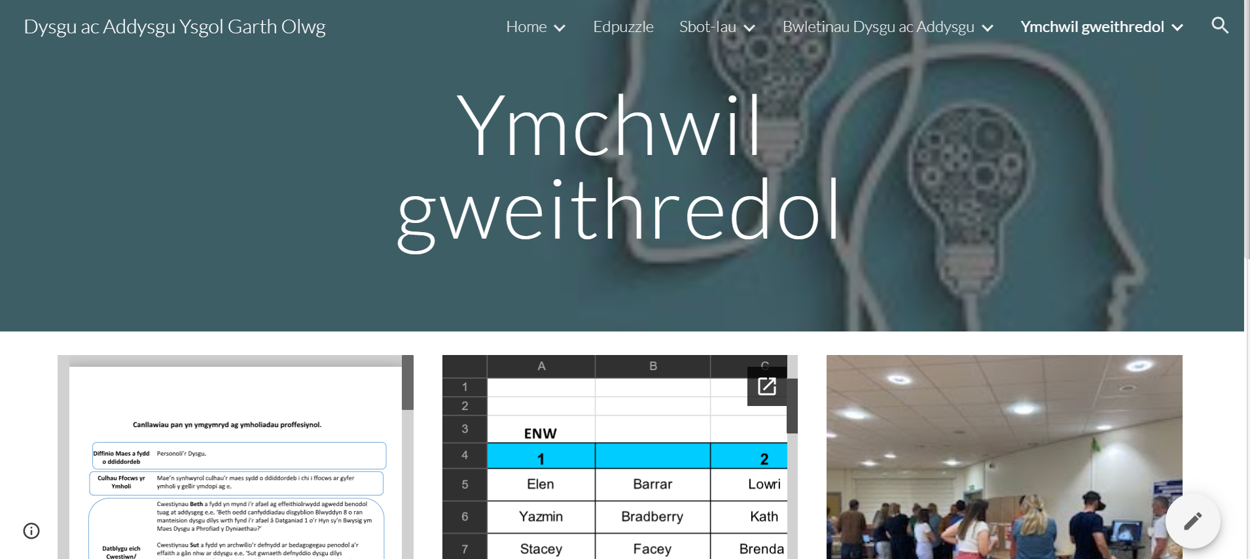

Slide 21
Ymchwil allanol Ysgol Garth Olwg 2019-2024
Fforwm ymchwil Ysgolion pob oed (2019 - 2021)
Beth yw barn a theimlad athrawon o ran addysgu ar draws sectorau gwahanol mewn ysgolion pob oed?
Ymchwil Llywodraeth Cymru
Prosiect arloesi mewn asesiadau sy'n gysylltiedig â’r Pandemig: goblygiadau i addysg athrawon (PAIR-AGA)
Ellen Bristow (PhD researcher at Cardiff University's Centre for Language and Communication research)
All age Schools Forum (2019 - 2021)
What is the opinion and feeling of teachers in terms of teaching across different sectors in All age Schools?
Welsh Government Research
Pandemic assessment innovation project: implications for teacher education
Ellen Bristow (PhD researcher at Cardiff University's Centre for Language and Communication research)

Slide 22
Prosiect Ymchwil Llywodraeth Cymru:
Llais y Dysgwr ac Asesu CA 4/5
Prosiect Ymholi Proffesiynol Cenedlaethol (PYPC)
Disgyblion: Prifysgol Cymru Aberystwyth –
Datblygu a dysgu Dosbarth Meistr ar derfysgoedd bwyd Merthyr Tudful 1800, a’r achosion llys yn eu sgil a arweiniodd at ddienyddiad dau ddyn ifanc.
Welsh Government Research:
Pupil Voice and Assessment in KS 4/5
National Professional Enquiry Project (NPEP)
Pupils: University of Wales, Aberystwyth –
Developing and teaching a Master Class on the Merthyr Tydfil food riots of 1800, and the resulting court cases which led to the execution of two young men.

Slide 23
Diolch yn fawr

